Slide 1
BT 601: Analytical Biotechnology
-Prof. Siddhartha Sankar Ghosh
Lec-3

Slide 2
Second generation sequencing
Illumina sequencing
Roche Pyrosequencing
Ion Torrent sequencing

Slide 3
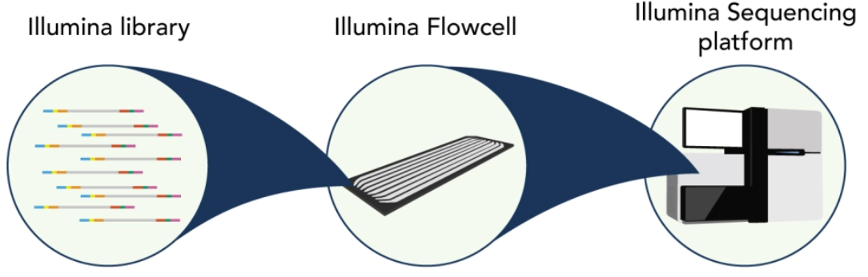
Illumina sequencing
https://www.youtube.com/watch?v=fCd6B5HRaZ8

Slide 4
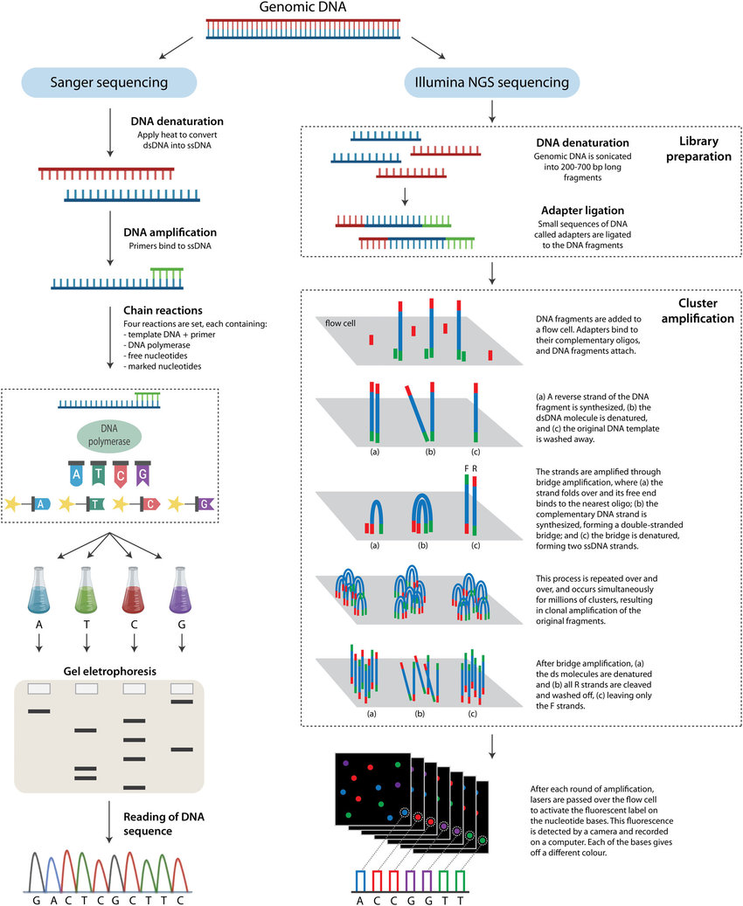
Illumina sequencing
Comparison between sanger and illumine sequencing

Slide 5
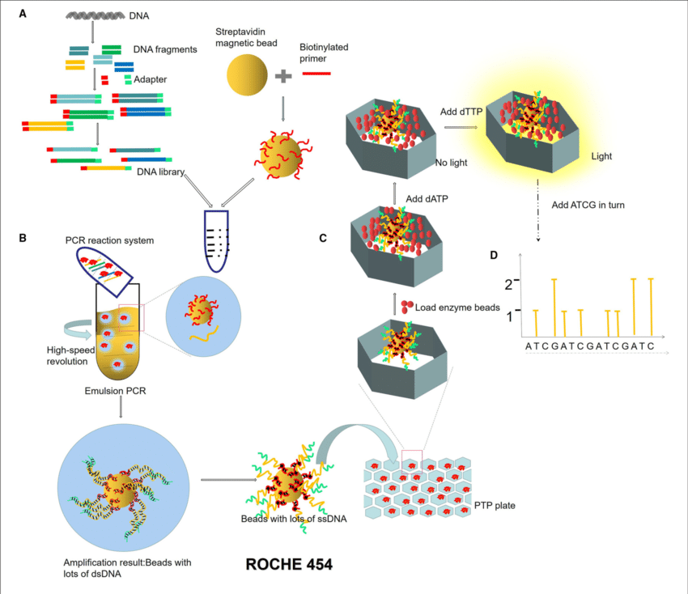
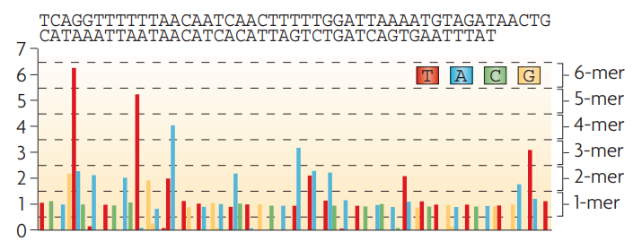
Roche/ 454 sequencing
Diagram: Sequencing the unknown strand from fold analysis of signal generation

Slide 6
Roche/ 454 sequencing
ROCHE / 454 sequencing process:
Construction of micro-reaction system. DNA library is constructed by adding an adapter at the ends of DNA fragments. The magnetic beads combined with primers are mixed in the PCR reaction system (DNA fragments, enzymes, dNTPs).
Emulsion PCR. PCR micro-reaction systems are formed by injecting water (PCR mixture) into the oil, and each system contained only one template and one bead.
Pyrophosphate sequencing. Pyrophosphate technology is an enzyme cascade chemiluminescence reaction in the same reaction system catalyzed by four enzymes. In each circle of the sequencing reaction, only one dNTP is added. If it just matches the next base of the DNA template, it will be added to the 3 ′ end of the sequencing primer under the action of DNA polymerase and release a molecular PPi at the same time. Under the action of ATP sulfurylase, luciferase, and apyrase, an enzyme cascade chemiluminescence reaction is triggered by the PPi.
Light signal reception.

Slide 7
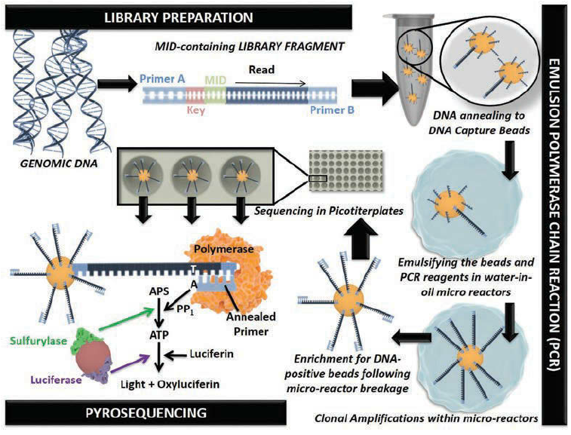
Roche/ 454 sequencing
Diagram: Stages of emulsion PCR and Pyrosequencing in 454 sequencing technology

Slide 8
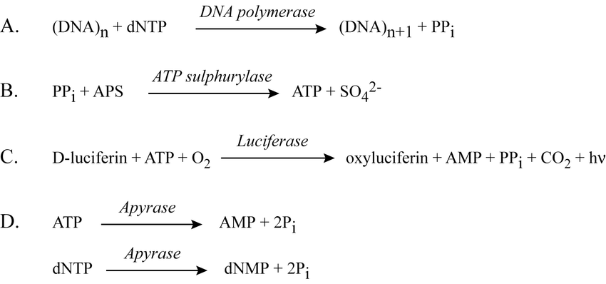
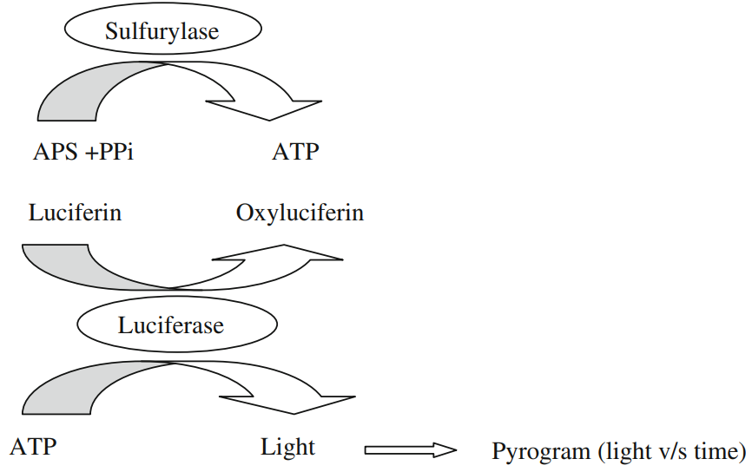
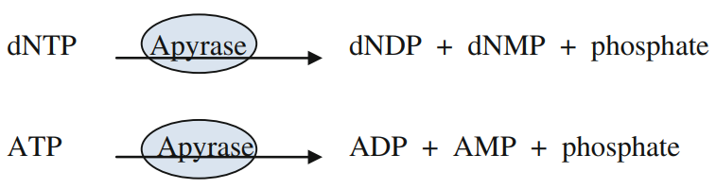
Pyro- sequencing:
Roche/ 454 sequencing
Addition of DNA polymerase and successive addition of nucleotides (dNTPs) leads to the release of one molecule of PPi
After successive nucleotide addition released PPi reacts to the another substrate APS. Under the action of ATP Sulfurylase it produces ATP.
ATP in turn interacts with luciferin present in the micro- reactor pore and gets converted into PPI, AMP and oxyluciferin to illuminate as light signal to confirm the successive dNTPs addition.
Unused dNTPs will undergo apyrase digestion, which will lead to avoidance of non- specific background noise generation (which may arise from unused dNTPs for successive next cycles)
Therefore, at the initiation of every cycle all 4 dNTPs (dATP, dTTP, dGTP, dCTP) are supplied to the micro- reactor pores and after the successive signal confirmation, the apyrase is poured into micro- reactor wells for digestion of unused nucleotides.
Thereafter, new cycle continues.

Slide 9
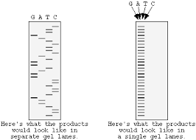
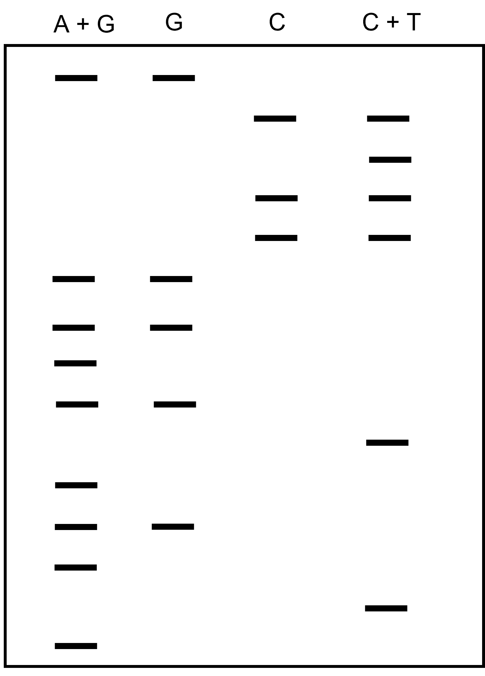
Possible Questions……
This gel autoradiograph image (Q. 1) is obtained from Sanger sequencing. Illustrate the sequence of dsDNA in 5′ to 3′ direction?
Read the sequences in 5′ to 3′ direction mentioned in Q. 2, that depicts the Maxam- gilbert sequencing?
Draw 2 applications with pros & cons of NGS technology in each case, where large scale sanger sequencing and microarray technologies can be used as alternative technology?
How ion torrent and 454 sequencing works? What are the similarities between them?
What are the functions of enzymes used in pyrosequencing based 454 sequencing? Draw their roles?
How, PCR bridge amplification works in Illumina sequencing?
Question. 1
Question. 2

Slide 10
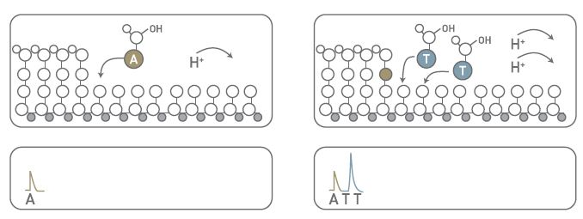
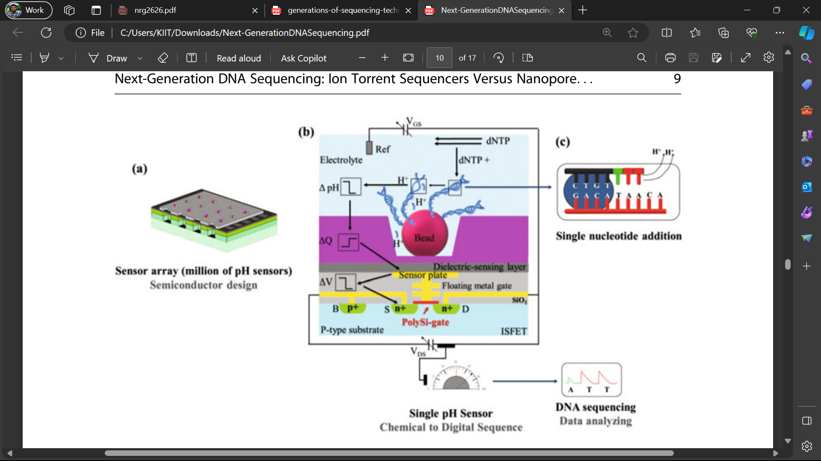
Ion torrent sequencing

Slide 11
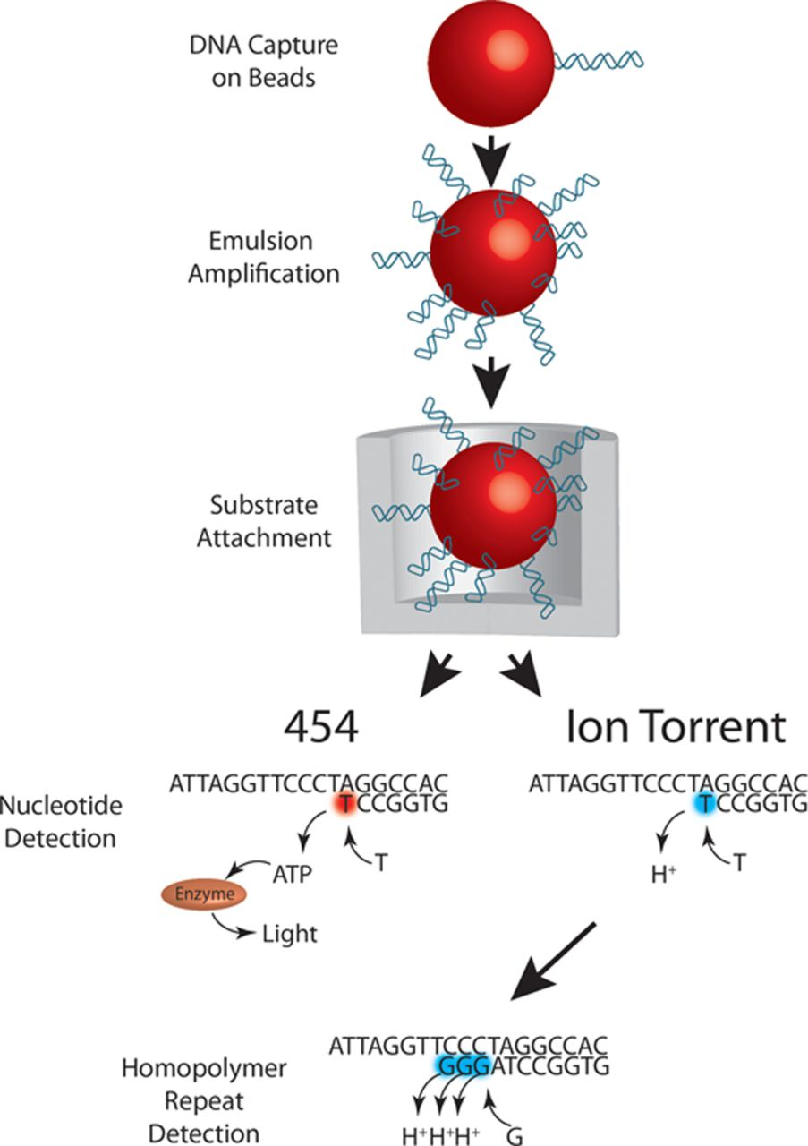
Ion torrent sequencing
Similarities in between 454 and Ion torrent sequencing

Slide 12
Principle:
Ion torrent sequencing
After the emulsion PCR is over, the oil is removed, and the DNA is shipped to the sensor microwell by carrier bead, which holds thousands of DNA fragments.
Sequencing begins when individual dNTPs are flooded over the surface of the chip, and the Ion Torrent’s sequence information is determined by the release of hydrogen ion (H⁺) with every nucleotide incorporated by the polymerase.
DNA + H_{i}dNTP DNA⁺¹ + H_{j}PPi + H_{k} [H_{i}dNTP= (dATP, dTTP, dGTP, dCTP), H_{j}PPi= pyrophosphate, H_{k} =hydrogen ion]
The ISFET gate is playing main role in H⁺ ion sensing.
The change of microwell pH due to the release of the hydrogen ion (H⁺) modulates the ISFET gate voltage.
The ISFET carries as a source follower; thus, the source potential is similar to the gate potential with an offset ascribed to the ISFET threshold. At this configuration, the ISFET and the current source both possess a high output resistance at their drain; hence, a constant current is maintained independently of the gate potential. The ISFET body is held at a constant voltage. The gain is slightly attenuated via the body effect, and the pH-ISFETs array is cycled successively by a read curtain from the chip boundary to the center. The ISFET is located onto a complementary metal-oxide-semiconductor (CMOS), converting the genetic information to a digital signal.

Slide 13
THANK YOU

